Slide 1


ANDROID COURSE
By: Mr Adnane Ayman

Slide 2
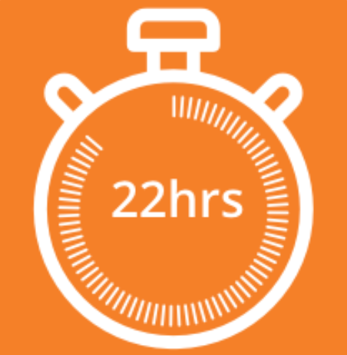

Chapter I
Android Basics
Chapter II
User Interface
Chapter III
Advanced & Useful Concepts (Practical Work)
4 hours
2 hours
12 hours

Slide 3



2 hours
Project Presentation
Final Exam
2 hours

Slide 4


Slide 5
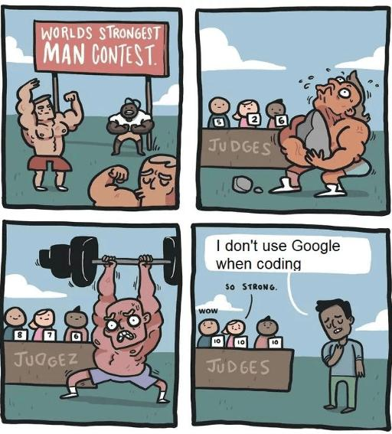
Facts

Slide 6
Chapter I: Android Basics
4 hours
Overview [What is android ? / why android? /features]
Environment Setup ( IDEs ):
Architecture
Application Components
Running my first application
Resources
Activities
Intents

Slide 7
Chapter II: User Interface
2 hours
UI layouts
UI Controls
Event handlings

Slide 8
Chapter III: Advanced & Useful Concepts: Practical Work
12 hours
Alert Dialogs
Auto Complete
Sending SMS
Sending Emails
Google maps (TP markers)
Progress Bars
Shared Preferences
SQLite / ORMs (Sugar)
Text to speech
Firebase(FirebaseAuthenticationManager + FirebaseDatabaseManager

Slide 9
INTRODUCTION TO ANDROID AND ANDROID STUDIO
Mr Adnane Ayman

Slide 10
What Will We Learn Today
Android Basics:
Overview [What is android ? / why android? /features]
Environment Setup ( IDEs ):
Architecture
Application Components
Running my first application
Resources
Activities
Intents

Slide 11

What is android ?
Android is the world’s most popular and dominant mobile operating system. It’s based on Linux and is open-source. It runs on a wide variety of hardware, including smartphones, smart watches, cars, televisions, digital cameras, game consoles and more. It was founded by Andy Rubin and three others in October 2003 and got acquired by Google in August 2005.

Slide 12
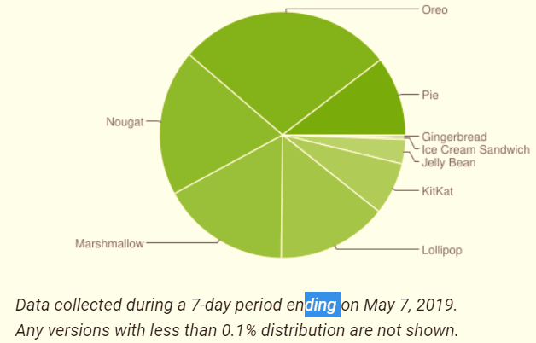
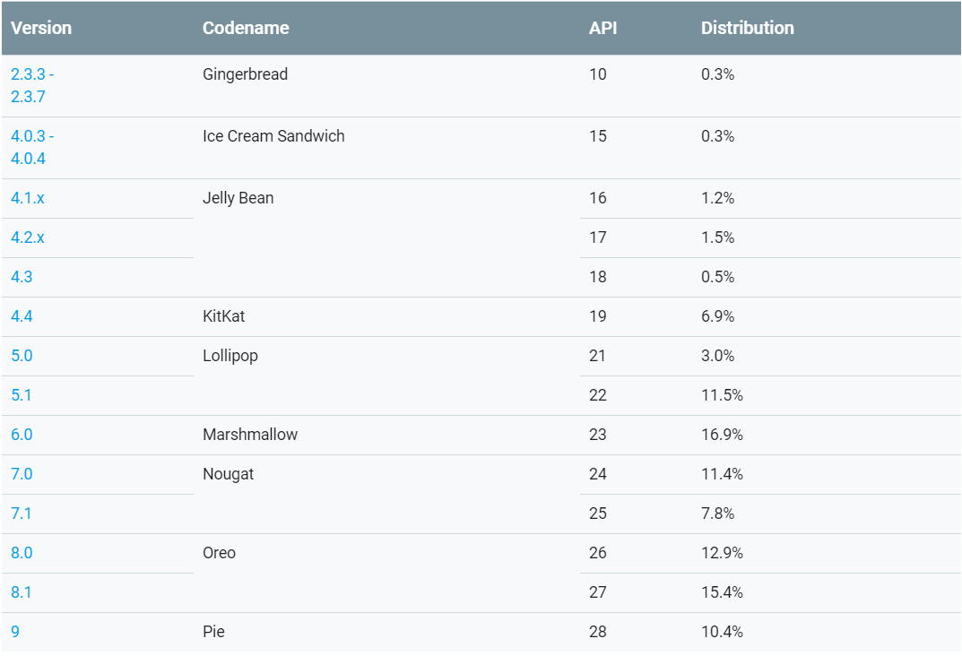
Distribution dashboard
2011
2018

Slide 13
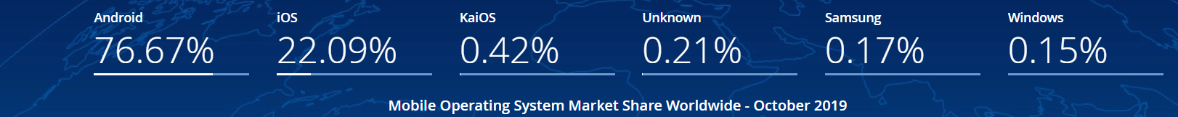
Worlwide Market Share
With Over 2.5 Billion monthly active users

Slide 14
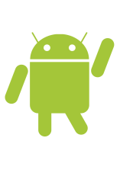
Why Android?
Android
Open Source
Larger Developer and community reach
Rich development Environment
Free SDK ,IDE and emulator
Distribute your app anywhere (Playstore, Amazon,Appstore …)

Slide 15
Features
Feature & Description
Beautiful UI Android OS basic screen provides a beautiful and intuitive user interface.
Connectivity GSM/EDGE, IDEN, CDMA, EV-DO, UMTS, Bluetooth, Wi-Fi, LTE, NFC and WiMAX.
Storage SQLite, a lightweight relational database, is used for data storage purposes.
Media support MP3, MIDI, Ogg Vorbis, WAV, JPEG, PNG, GIF, SVG …
Messaging SMS and MMS
Web browser Based on the open-source WebKit layout engine, coupled with Chrome's V8 JavaScript engine supporting HTML5 and CSS3.
Feature & Description
Multi-touch Android has native support for multi-touch which was initially made available in handsets.
Multi-tasking User can jump from one task to another and same time various application can run simultaneously.
GCM Google Cloud Messaging (GCM) is a service that lets developers send short message data to their users on Android devices, without needing a proprietary sync solution.
Android Beam A popular NFC-based technology that lets users instantly share, just by touching two NFC-enabled phones together.

Slide 16
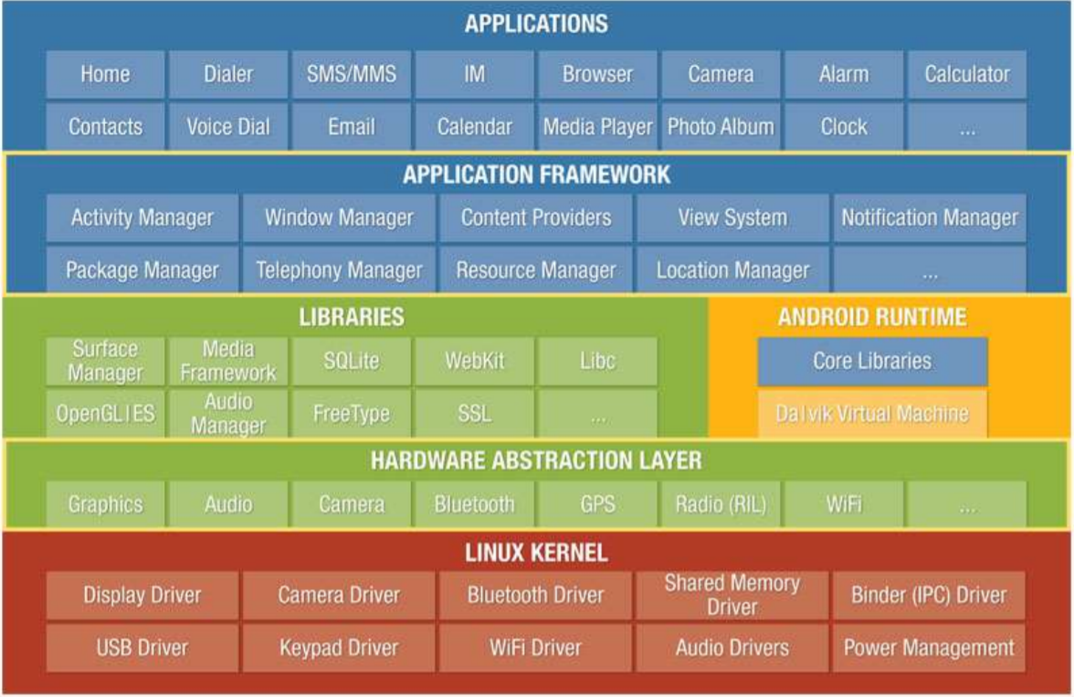
Android Plateform Overview

Slide 17
Android Plateform Overview
Android is actually a system of the Linux family, for once without the GNU tools. The OS is based on:
A Linux kernel (and its drivers)
a virtual machine: Dalvik Virtual Machine
applications (browser, contact management, telephony application ...)
[Dalvik] is the name of the open-source virtual machine used on Android systems. This virtual machine is running .dex files and is not compatible with a JVM of the type Java SE or even Java ME

Slide 18
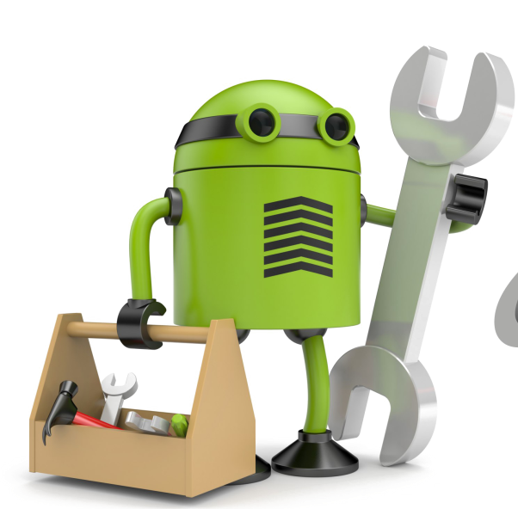
What Do I Need To Build An Android App?
Java Programming Language & XML
Android SDK & SDK Tools
Android Studio
The desire to learn

Slide 19
Environment Setup ( IDEs ):
You can start the development of your Android application on one of the following operating systems:
Microsoft Windows XP or later.
Mac OS X 10.5.8 or later with Intel chip.
Linux, including GNU C Library 2.7 or later.
Second, all the tools needed to develop Android apps are available for free and can be downloaded from the web. Below is a list of the software you will need before you start programming your Android application.
Java JDK5 or later
Android Studio

Slide 20
Environment Setup ( IDEs ):
You can download the latest version of Java JDK from Oracle's Java site
− Java SE Downloads. You will find instructions for installing JDK in downloaded files, follow the given instructions to install and configure the setup. Finally set PATH and JAVA_HOME environment variables to refer to the directory that contains java and javac, typically java_install_dir/bin and java_install_dir respectively.
Android IDEs
There are so many sophisticated Technologies are available to develop android applications, the familiar technologies, which are predominantly using tools as follows
Android Studio
Eclipse IDE(Deprecated)

Slide 21
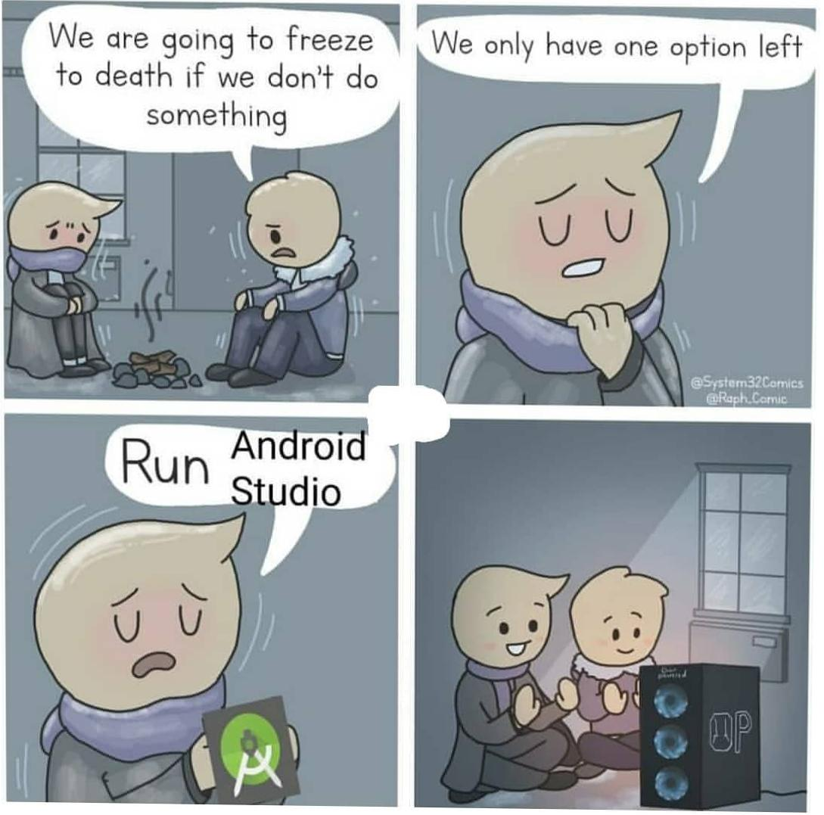

Slide 22
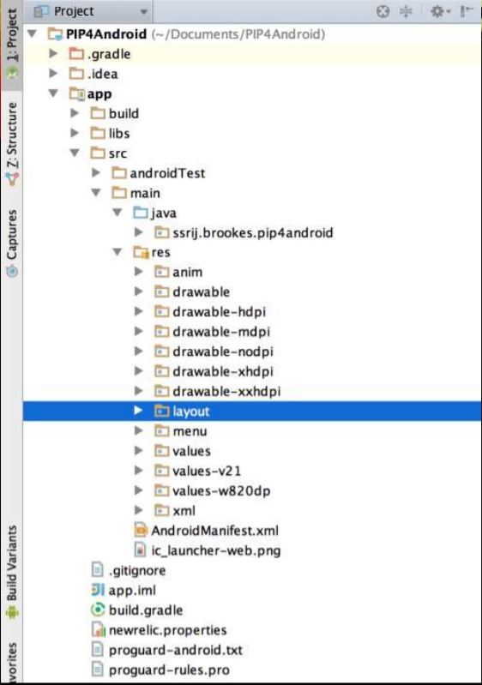
Architecture
• Java: Java class files containing app logic
• Res: Different resource files
• Anim: Animation resource files
• Drawable: Images
• Drawable-Xdpi: Images depending on screen density
• Layout: App layout files
• Menu: Layout menu files
• Values: Value files (strings, colors, arrays, etc)
• Values-vX: Value files depending on API level
• Values-Xdp: Value files depending on screen density
• XML: XML files
• AndroidManifest.xml: App metadata file
• build.gradle: Build related settings

Slide 23
Application Components
Application components are the essential building blocks of an Android application. These components are loosely coupled by the application manifest file AndroidManifest.xml that describes each component of the application and how they interact.
There are following four main components that can be used within an Android application :

Slide 24
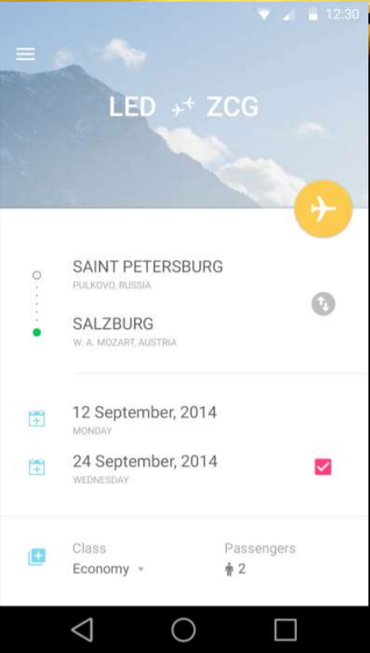
Activities
They dictate the UI and handle the user interaction to the smart phone screen
Every app has at least one activity
Activities can be full-screen, floating or embedded inside another activity

Slide 25
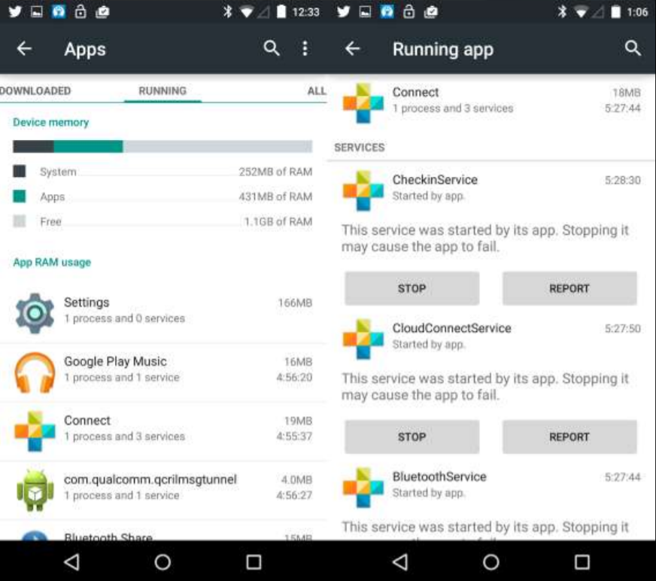
Services
A service is a long running operation in the background
There are two types of services in Android – Bounded (which runs as long as components which bind to it run) and Unbounded (which runs indefinitely)
Services run on the main thread of the application by default

Slide 26
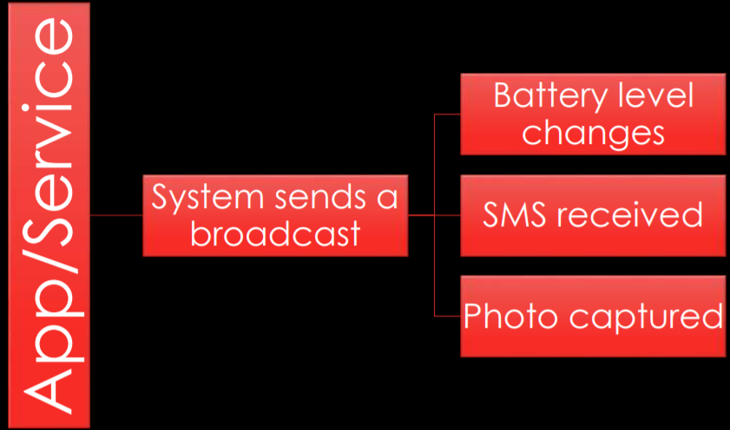
BroadcastReceiver
A broadcast is a system or app event that can be “broadcasted” so other apps/services can listen for it
Broadcasts are handled by a BroadcastReceiver, which is a component that allows you to listen for broadcasts
A BroadcastReceiver can be implemented in AndroidManifest.xml, or dynamically by calling registerReceiver(), or both

Slide 27
Content Providers/Resolvers
App Database
Update
Delete
Fetch
Insert
A content provider allows you to store data in your app in a structured way, similar to a relational database like SQL, for the purpose of providing it to other apps. Example usage: Contacts app, SMS app, etc
A content resolver allows you to get data from a content provider or manipulate its data (modify, delete, update, etc)
You cannot request to read data from a content provider at runtime, it has to be declared in AndroidManifest.xml

Slide 28
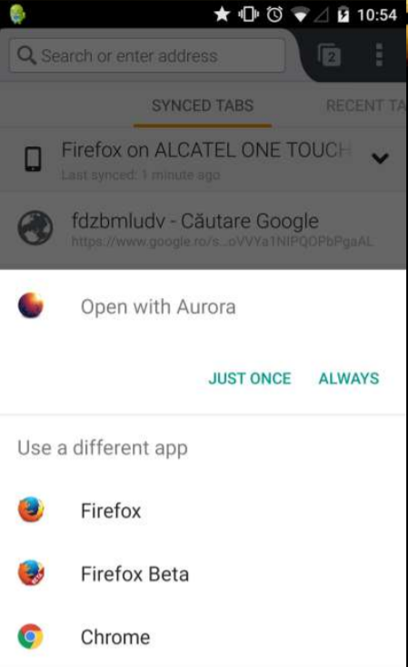
Additional Components
Intents
An intent is an abstract description of an operation to be performed. Think of it as an “intention” to do something
Intents can be used to start activities, services or send a broadcast
Intents are of two types – Explicit (when you know what exactly you want to do), and Implicit (when you’re not sure what you want to do)

Slide 29
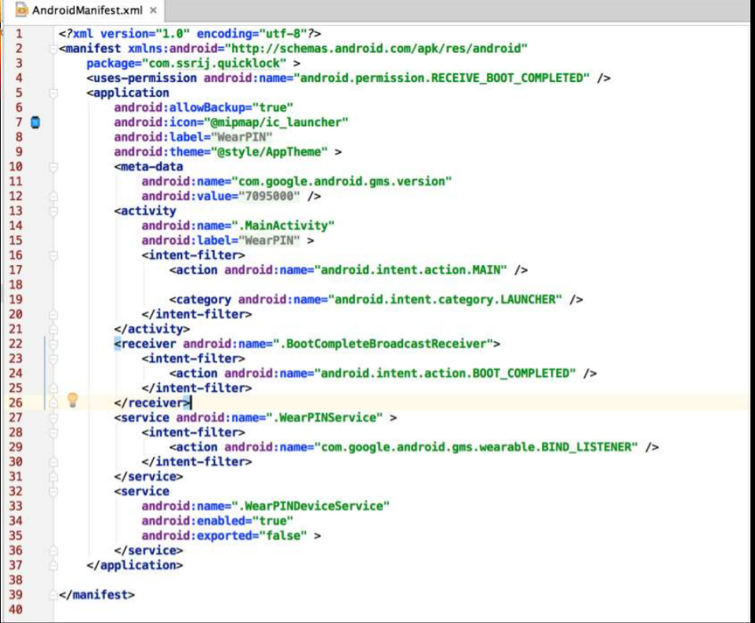
AndroidManifest.XML
Is the file which describes the fundamental characteristics of the app and defines each of its components.

Slide 30
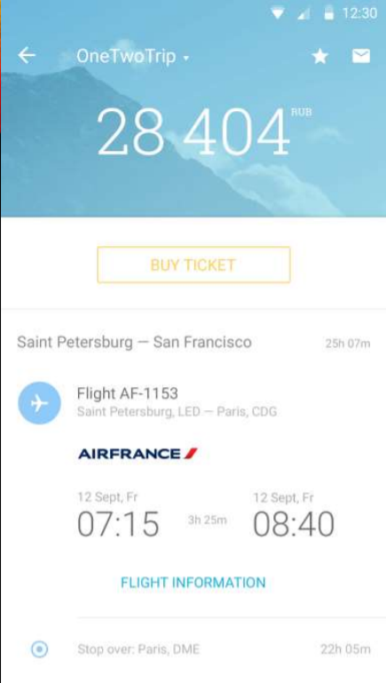
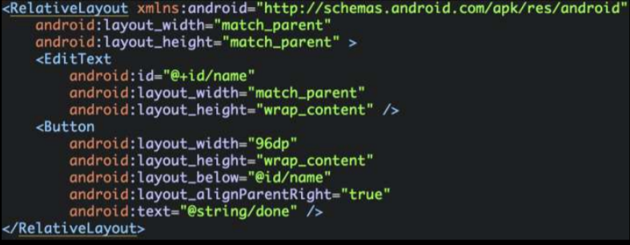
Layouts
A layout defines the visual structure for a user interface, such as the UI for an activity or app widget
Layouts can be defined both in XML or programmatically using View and ViewGroup objects
There are 5 different types of Layouts in Android: LinearLayout, RelativeLayout, FrameLayout, TableLayout and AbsoluteLayout

Slide 31
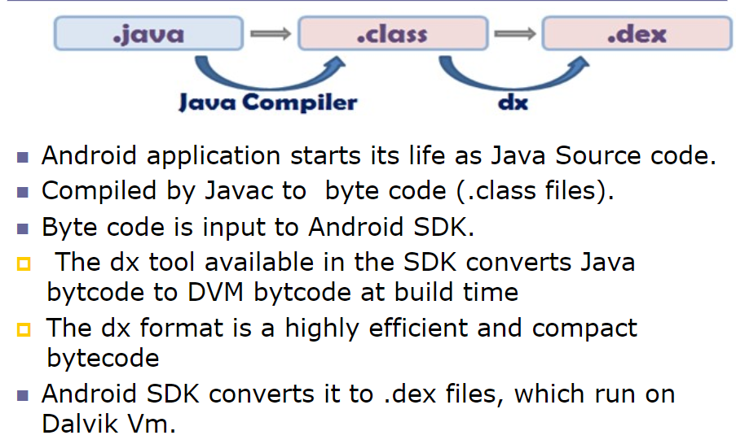
Life cycle of Android application

Slide 32
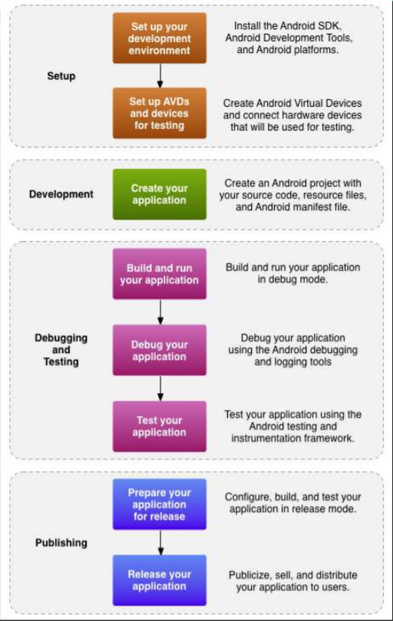
Workflow

Slide 33
Running my first application
The first step is to create a simple Android Application using Android studio. When you click on Android studio icon, it will show screen as shown here:

Slide 34
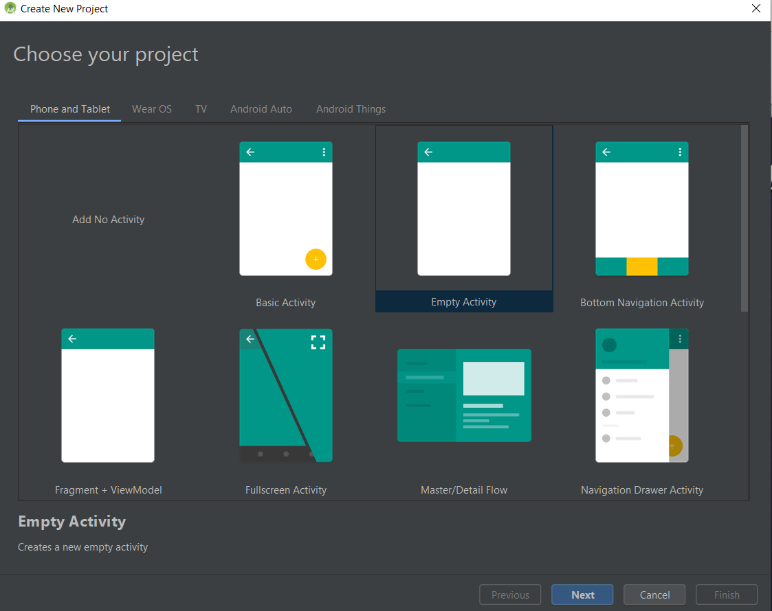
Running my first application
The next level of installation should contain selecting the activity to mobile, it specifies the default layout for Applications.

Slide 35
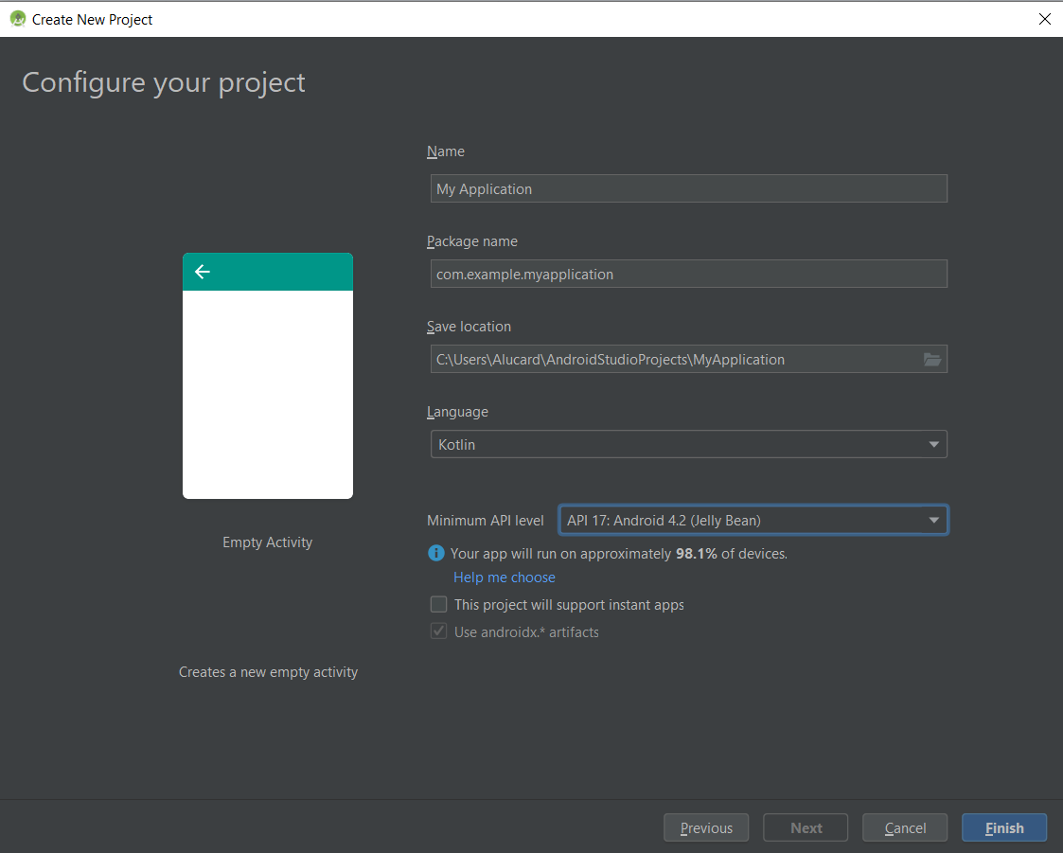
Running my first application
A new installation frame should ask Application name, package information and location of the project. You need to specify Minimum SDK, and declare as API:17 Android 4.2(Jelly Bean)

Slide 36
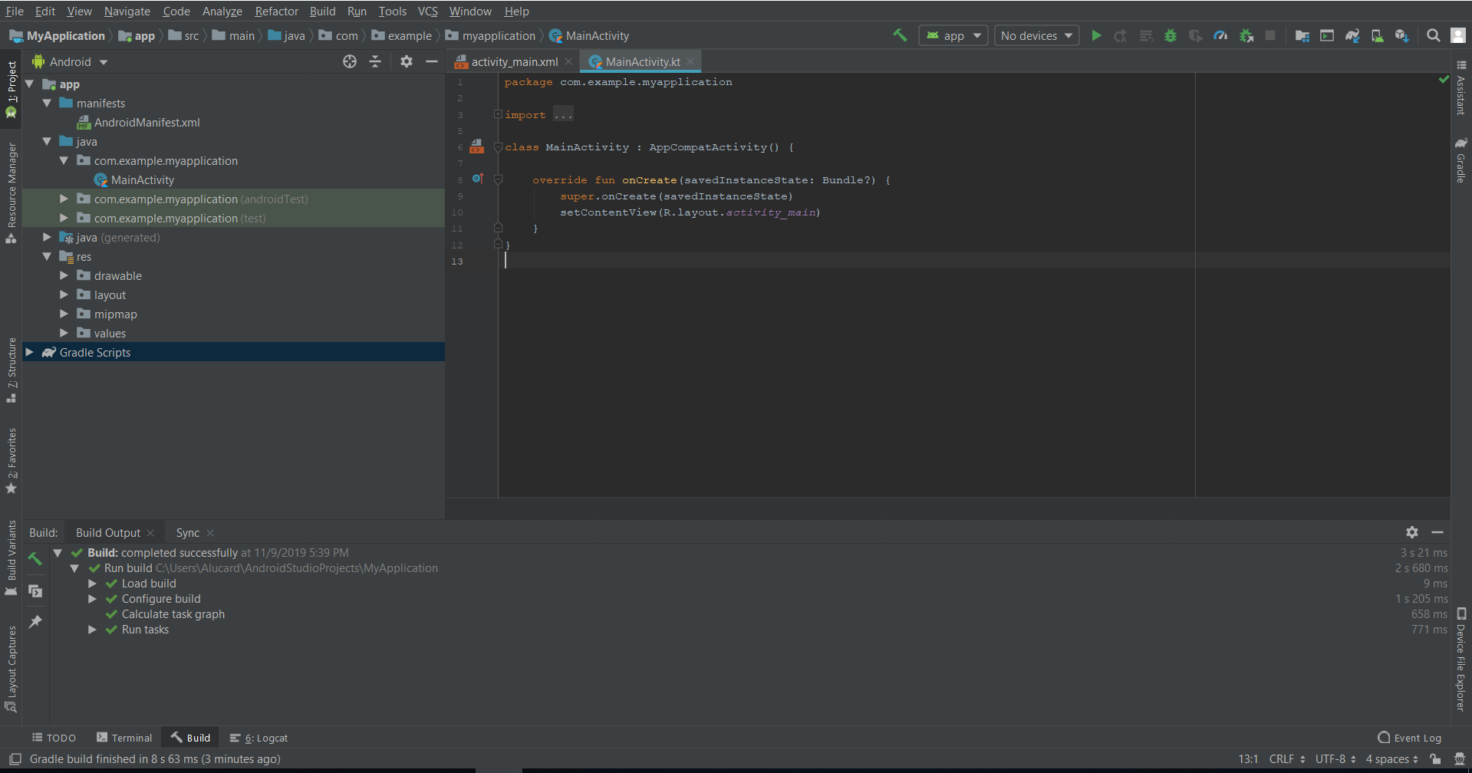
At the final stage it going to be open development tool to write the application code.

Slide 37
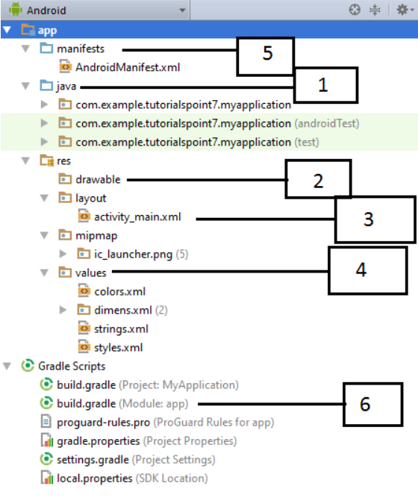
Anatomy of Android Application
Java => Contains the .java source files for your project.
res/drawable => A directory for drawable objects
res/layout => A directory for files that define your app's UI
res/values => A directory for other various XML files that contain a collection of strings and colours definitions…
AndroidManifest.xml
Build.gradle => contains compileSdkVersion, buildToolsVersion, applicationId, minSdkVersion, targetSdkVersion, versionCode and versionName

Slide 38
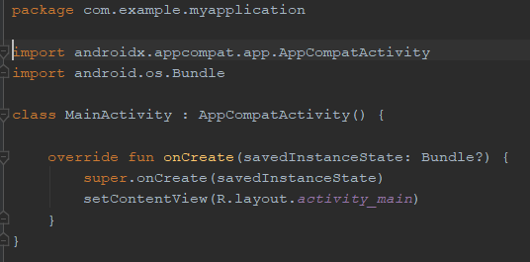
The Main Activity File
The main activity code is a Java file MainActivity.java. This is the actual application file which ultimately gets converted to a Dalvik executable and runs your application. Following is the default code generated by the application wizard for
Hello World! application
Here, R.layout.activity_main refers to the activity_main.xml file located in the res/layout folder. The onCreate() method is one of many methods that are figured when an activity is loaded.

Slide 39
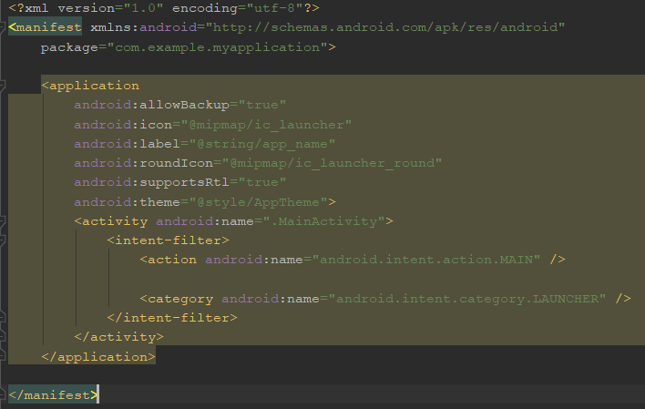
The Manifest File
Following is the list of tags which you will use in your manifest file to specify different Android application components :
<activity>elements for activities; <service> elements for services ;<receiver> elements for broadcast receivers ;<provider> elements for content providers

Slide 40
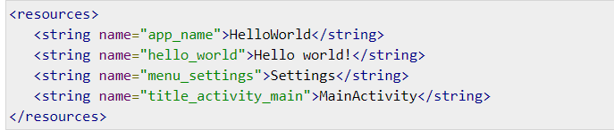
The Strings File
The strings.xml file is located in the res/values folder and it contains all the text that your application uses. For example, the names of buttons, labels, default text, and similar types of strings go into this file.

Slide 41
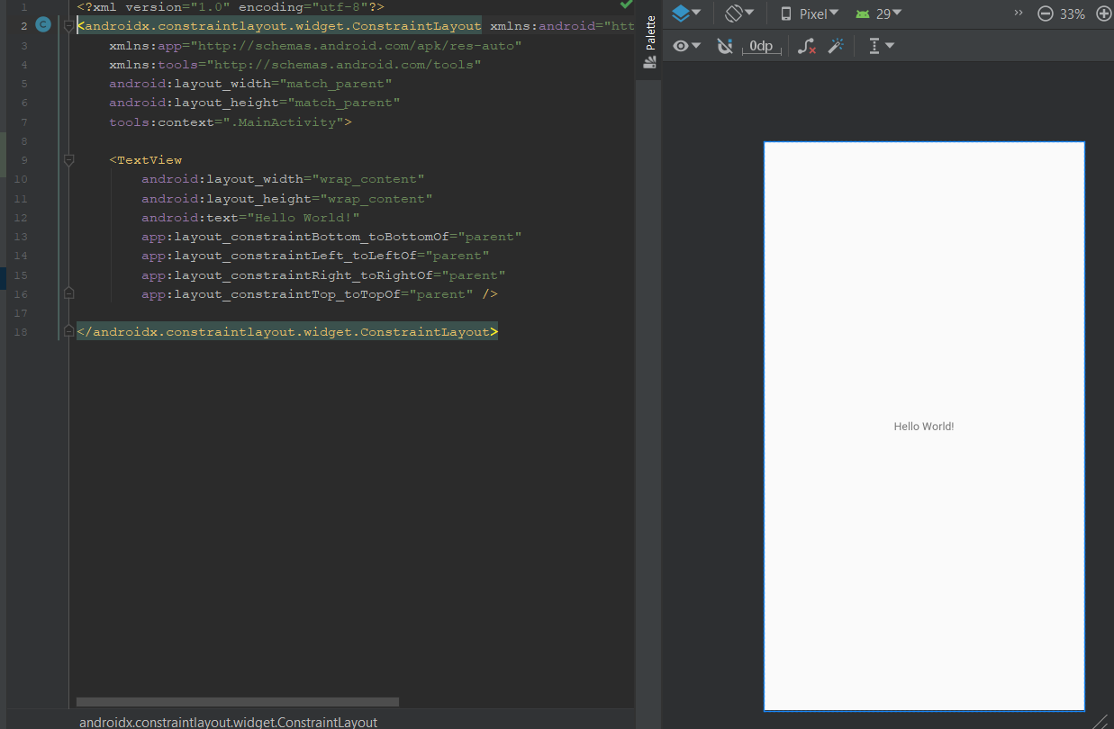
The Layout File
The activity_main.xml is a layout file available in res/layout directory, that is referenced by your application when building its interface

Slide 42
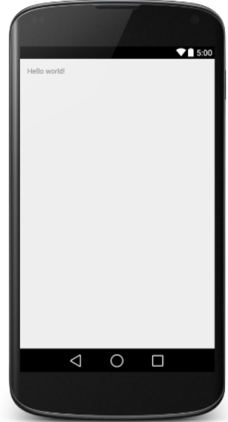
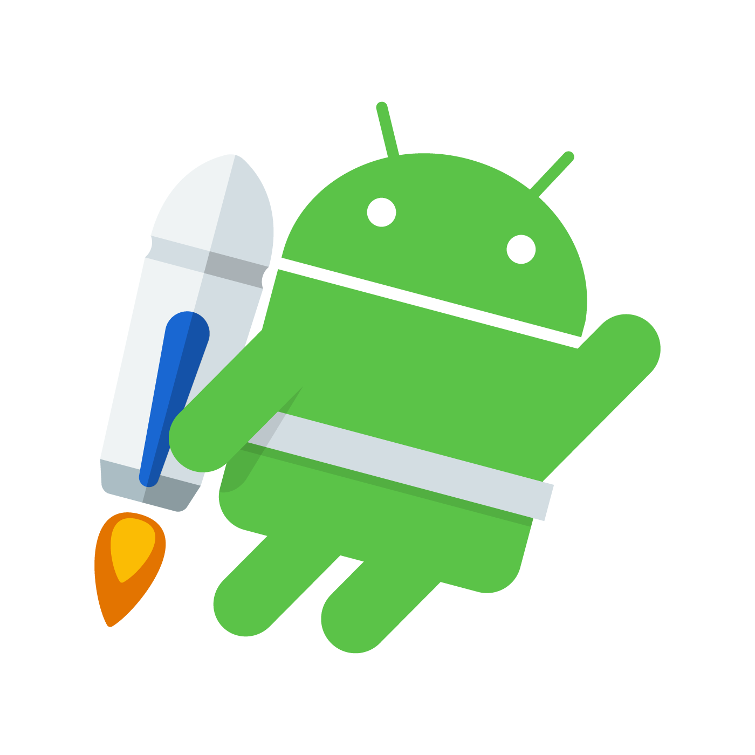
Running the application
Congratulations!!! you have developed your first Android Application

Slide 43
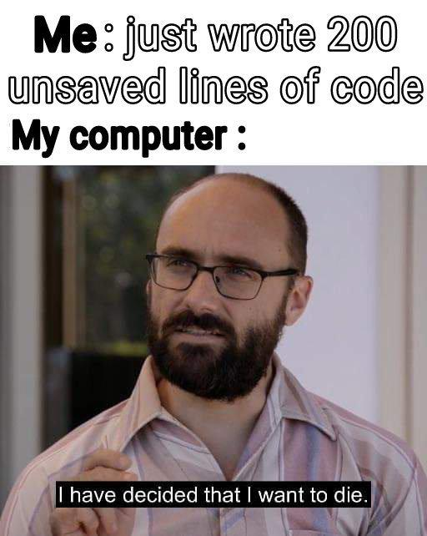
Friendly reminder

Slide 44
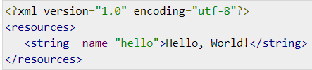
Accessing Resources in Code
When your Android application is compiled, a R class gets generated, which contains resource IDs for all the resources available in your res/ directory. You can use R class to access that resource using sub-directory and resource name or directly resource ID
Example 1 :
To access res/drawable/myimage.png and set an ImageView you will use following code:
ImageView imageView = (ImageView) findViewById(R.id.myimageview);
imageView.setImageResource(R.drawable.myimage);
Example 2:
Consider next example where res/values/strings.xml has following definition
Now you can set the text on a TextView object with ID msg using a resource ID as follows :
TextView msgTextView = (TextView) findViewById(R.id.msg); msgTextView.setText(R.string.hello);

Slide 45
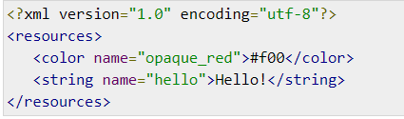
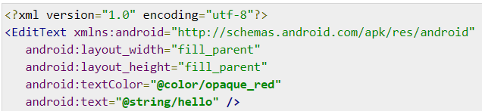
Accessing Resources in Code
Example 3 :
Consider the following resource XML res/values/strings.xml file that includes a color resource and a string resource:
Now you can use these resources in the following layout file to set the text color and text string as follows :

Slide 46
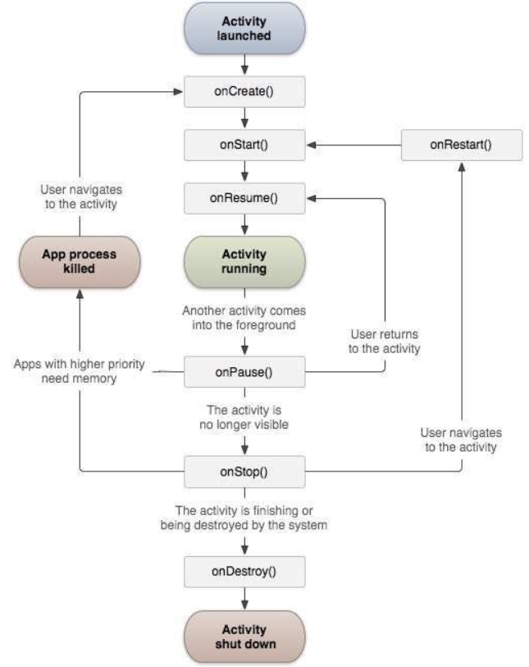
The Application life cycle
Click here

Slide 47
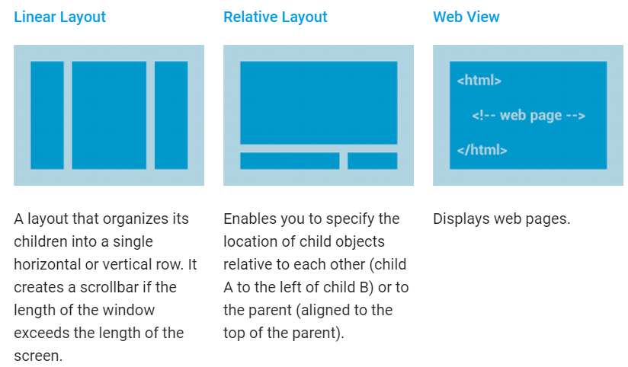
Layouts

Slide 48
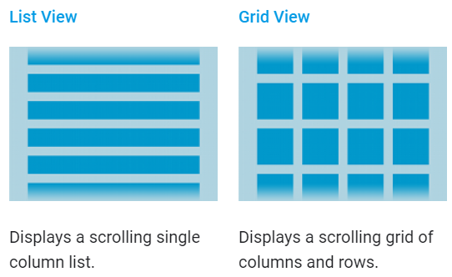
Layouts
When the content for your layout is dynamic or not pre-determined, you can use a layout that subclasses AdapterView to populate the layout with views at runtime.

Slide 49
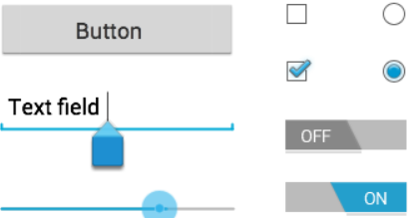
UI Controls
Input controls are the interactive components in your app's user interface. Android provides a wide variety of controls you can use in your UI, such as buttons, text fields, seek bars, check box, zoom buttons, toggle buttons, and many more.

Slide 50
UI Controls
Input controls are the interactive components in your app's user interface. Android provides a wide variety of controls you can use in your UI, such as buttons, text fields, seek bars, check box, zoom buttons, toggle buttons, and many more.
Example 1: Button with id = myButton
Step 1:
Public class MainActivity extends AppCompatActivity implements View.OnClickListener
Step 2:
Private Button button;
(inside on create)=>
button = (Button) findViewById(R.id.myButton);
button.setOnClickListener(this);

Slide 51
UI Controls
Example 1: Button with id = myButton
Step 3:
@override
Public void onClick(View view) {
if(view == myButton){
//traitement+ toast
Toast.makeText(getApplicationContext(),“click!!",Toast.LENGTH_SHORT).show();
}
}

Slide 52
UI Controls
Example 2: Button style
https://angrytools.com/android/button/
Step 1: paste the xml generated code in layout.xml
Step 2: paste the buttonShape.xml generated code in the drawable folder
Example 3 : changing case of textview
TP ; help (getText,setText , toLowerCase, toUpperCase)
Notes:
String tolowercase = name.getText().toString().toLowerCase(); text.setText(String.valueOf(tolowercase));

Slide 53
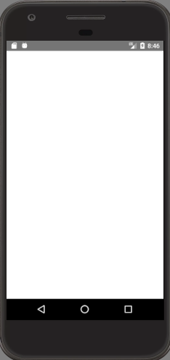
UI Controls
Example 4 : Basic calculator
num1
OP
num2
+
Result : XX
-
x
/

Slide 54
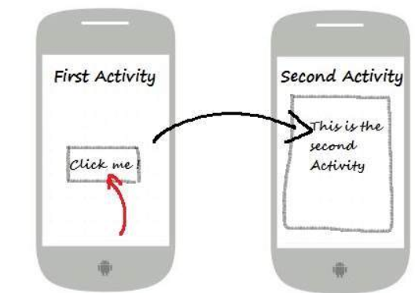
Intents
An Android Intent is an abstract description of an operation to be performed.
Example 1 :
// Explicit Intent by specifying its class name
Intent i = new Intent(FirstActivity.this, SecondActivity.class);
// Starts TargetActivity
startActivity(i);
These intents (explicit) designate the target component by its name and they are typically used for application-internal messages - such as an activity starting a subordinate service or launching a sister activity.

Slide 55
Intents
Example 1 : Implicit Intent
String q = “Tesla";
Intent intent = new Intent(Intent.ACTION_WEB_SEARCH );
intent.putExtra(SearchManager.QUERY, q);
startActivity(intent);

Slide 56
Login Page
Login
Case user unknown
**********
Example 4 :
Main Screen
Connect
Login
**********
Connect
Case user known
New Activity
+
greetings

Slide 57
Notifications
Android Toast class provides a handy way to show users alerts but problem
is that these alerts are not persistent which means alert flashes on the screen
for a few seconds and then disappears.
Example :
Step 1: Create Notification Builder
NotificationCompat.BuildermBuilder=new NotificationCompat.Builder(this);
Step 2: Once you have Builder object, you can set its Notification properties using Builder object as per your requirement. But this is mandatory to set at least following −
A small icon, set by setSmallIcon()
A title, set by setContentTitle()
Detail text, set by setContentText()
=>
mBuilder.setSmallIcon(R.drawable.notification_icon); mBuilder.setContentTitle("Notification Alert, Click Me!"); mBuilder.setContentText("Hi, This is Android Notification Detail!");

Slide 58
Notifications
Example :
Step 3: Attach Actions
This is an optional part and required if you want to attach an action with the notification. An action allows users to go directly from the notification to an Activity in your application
Intent resultIntent = new Intent(this, MainActivity.class);
TaskStackBuilder stackBuilder = TaskStackBuilder.create(this);
stackBuilder.addParentStack(MainActivity.class);
// Adds the Intent that starts the Activity to the top of the stack
stackBuilder.addNextIntent(resultIntent);
PendingIntent resultPendingIntent = stackBuilder.getPendingIntent(0,PendingIntent.FLAG_UPDATE_CURRENT); mBuilder.setContentIntent(resultPendingIntent);

Slide 59
Notifications
Example :
Step 4: Issue the notification
Finally, you pass the Notification object to the system by calling NotificationManager.notify() to send your notification.
NotificationManager mNotificationManager = (NotificationManager) getSystemService(Context.NOTIFICATION_SERVICE);
// notificationID allows you to update the notification later on.
mNotificationManager.notify(notificationID, mBuilder.build());

Slide 60
Sugar ORM (SQLite)
Step 1: Download via Gradle :
implementation 'com.github.satyan:sugar:1.5‘
Step 2: Manifest File inside Application :
android:name="com.orm.SugarApp“
outside <Application>
<meta-data android:name="DATABASE" android:value=“Vehicles.db" /> <meta-data android:name="VERSION" android:value="2" /> <meta-data android:name="QUERY_LOG" android:value="true" /> <meta-data android:name="DOMAIN_PACKAGE_NAME" android:value="com.example.myapplication.vehiclesModel" />

Slide 61
Sugar ORM (SQLite)
Step 3: Create the Model :
Step 4: Create the Layout / Activity:

Slide 62
Sending a Mail
Example .
// You will use ACTION_SEND action to launch an email client installed on your
Android device
Intent email = new Intent(Intent.ACTION_SEND, Uri.parse("mailto:"));
email.putExtra(Intent.EXTRA_EMAIL, recipients);
email.putExtra(Intent.EXTRA_SUBJECT, subject.getText().toString());
email.putExtra(Intent.EXTRA_TEXT, body.getText().toString());
startActivity(Intent.createChooser(email, "Choose an email client from..."));

Slide 63

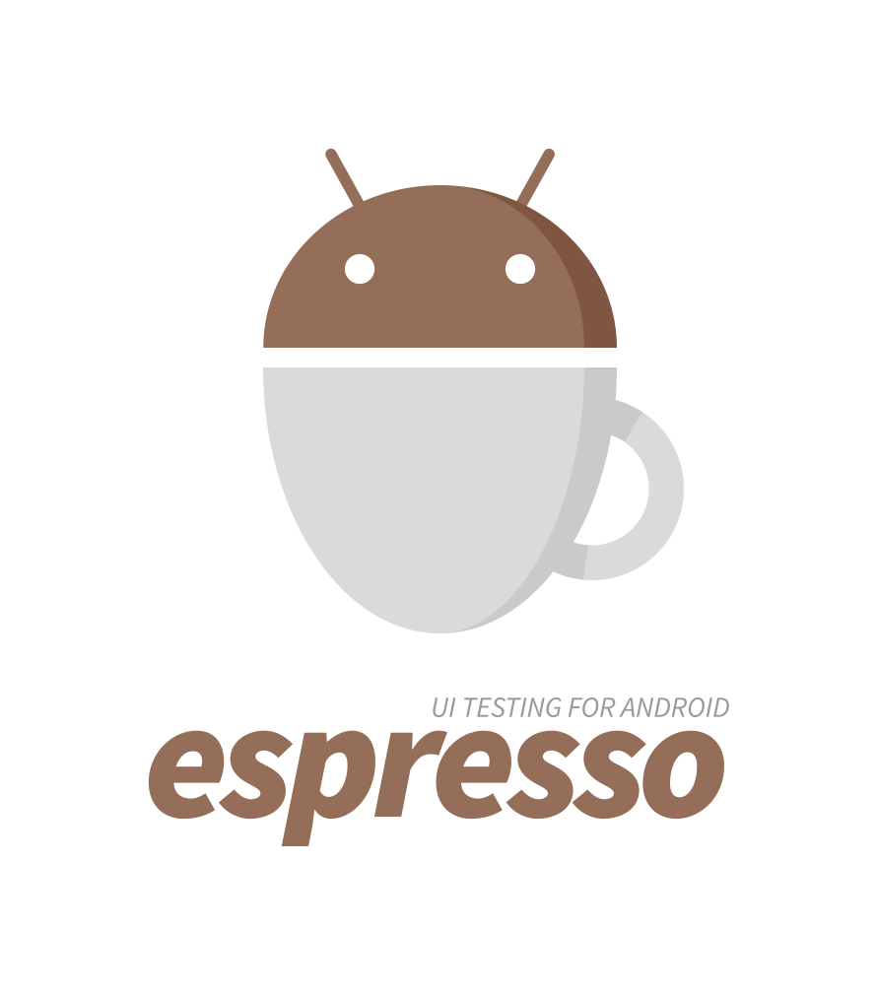
Tests
Example 1 : Robolectric
http://robolectric.org/
Example 2 : Espresso
https://developer.android.com/training/testing/espresso

Slide 64
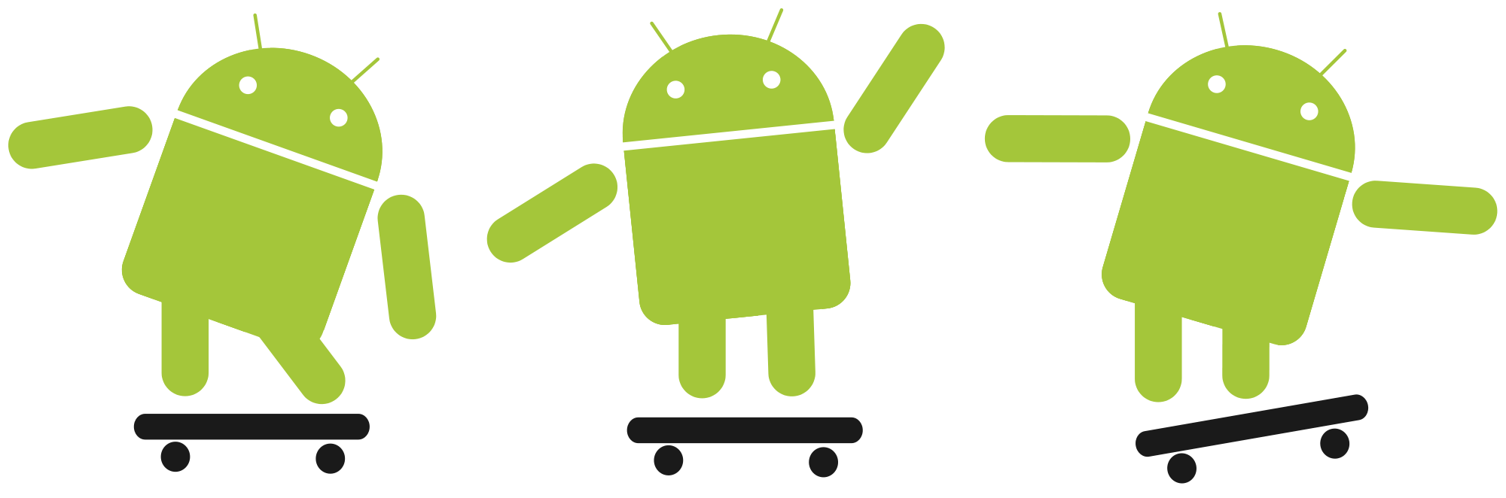

Any Questions?
ME
YO
ASK
Is coding an instrument?

